Slide 1
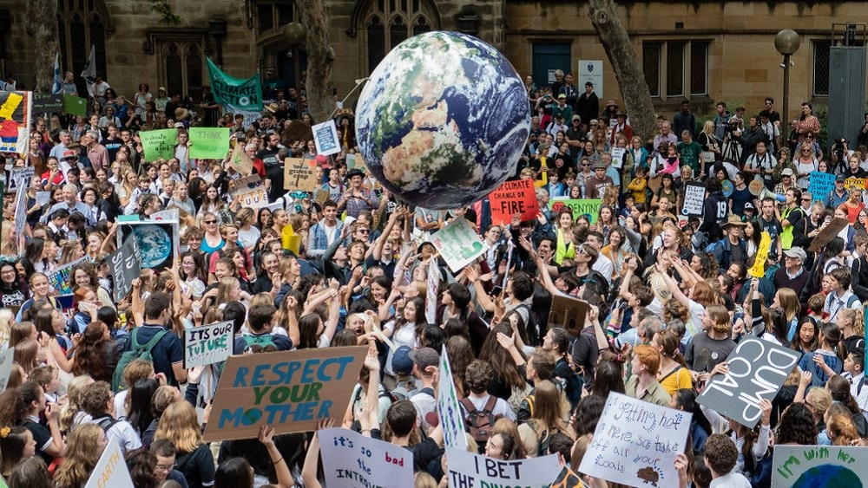
ER 131 Final Project
Predicting County-Level Climate Beliefs
Akshay Thakur

Slide 2
Project Background and Motivation
Problem: Citizens increasingly care about climate change. Politicians would like data to build their campaigns.
Current solution:
Conduct polling themselves
Community town halls about climate
Yale Climate Opinion Maps
National polling

Slide 3
Project Background and Motivation
Problem: Citizens increasingly care about climate change. Politicians would like data to build their campaigns.
Conduct polling themselves
Community town halls about climate
Data is not local enough OR too late to be useful
X
Yale Climate Opinion Maps
National polling
Proposed solution
Conduct polling themselves
Community town halls about climate
Model’s output
National polling,
Yale Data
Ultimately, this model allows politicians to get county-level data in a timely manner for campaign planning.

Slide 4
3 Prediction Problems
Using data from prior years, we aim to predict future climate beliefs by county
1
Proportion responding yes to “Are you worried about climate change?”
Resource Allocation
Allow politicians to use climate opinion data to drive campaigns (i.e. messaging, advertising dollars, location of climate events)
2
Proportion responding yes to “Do you support CO₂ limits on power plants?”
3
Proportion responding yes to “Do you think climate change will harm people in the US?”

Slide 5
Data Sets Used
Target
% of people who...
Features
Are worried about climate change
Demographic Data
Voting data from general & midterm elections
County population & educational attainment
Unemployment rate & employment in “extractive” industries
Support CO₂ limits on power plants
Environmental Data
Extreme heat events
# of fossil fuel plants per countries
Times a president mentioned “Climate”
Think climate change will harm people in the US
Largest limitation: finding national datasets at a county-level

Slide 6
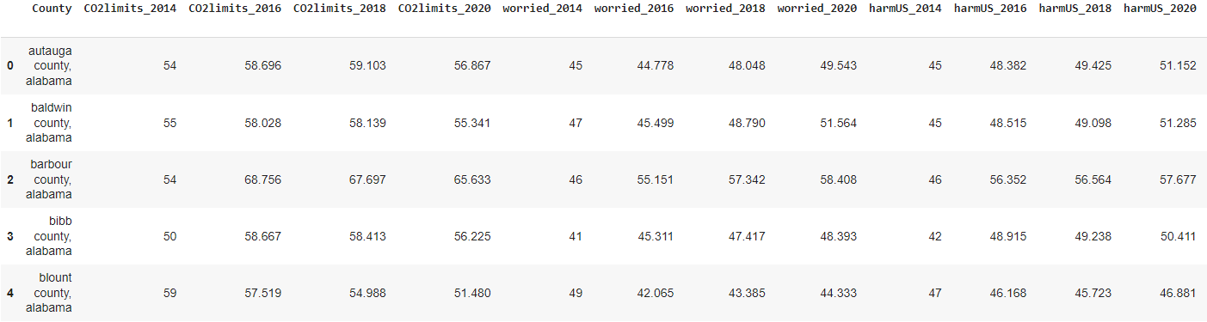
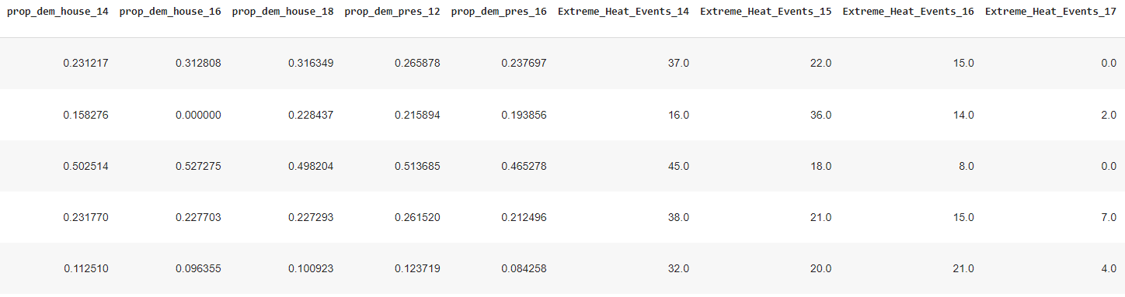
Data Cleaning
Major Challenges
Output
Dealing with county naming conventions:
Some datasets refer to some counties in LA as “Parish;” others call them “County. Analogous issues with VA.
Merging without dropping rows:
First ensured all target datasets had same counties. Then checked for NaN after left merging all features with target.
. . .
. . .
Dealing with multi-year datasets:
Saved time by writing functions to clean, extract data for each year. Used functions to separate years.
approximately 3000 more rows
Notes:
Speaker notes: obviously there’s a lot we could have described in cleaning, but we juust want to highlight a few things, and ultimate goal

Slide 7
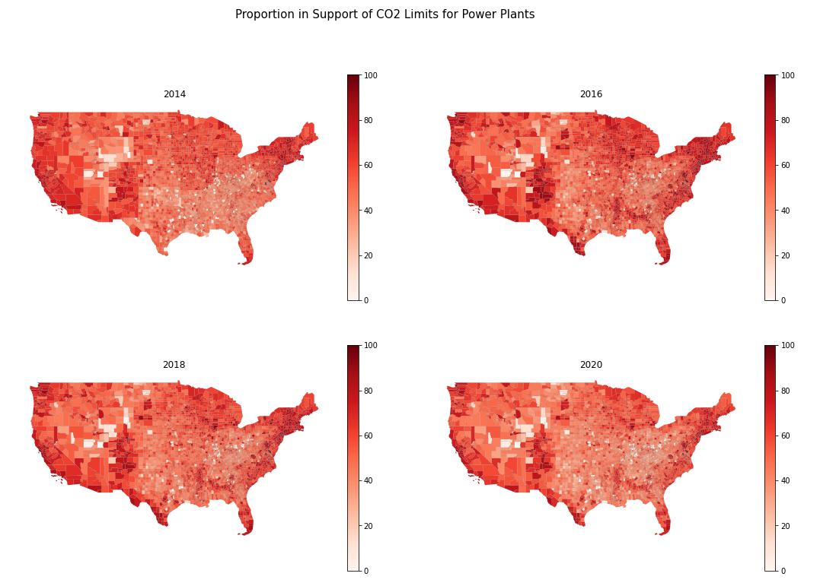
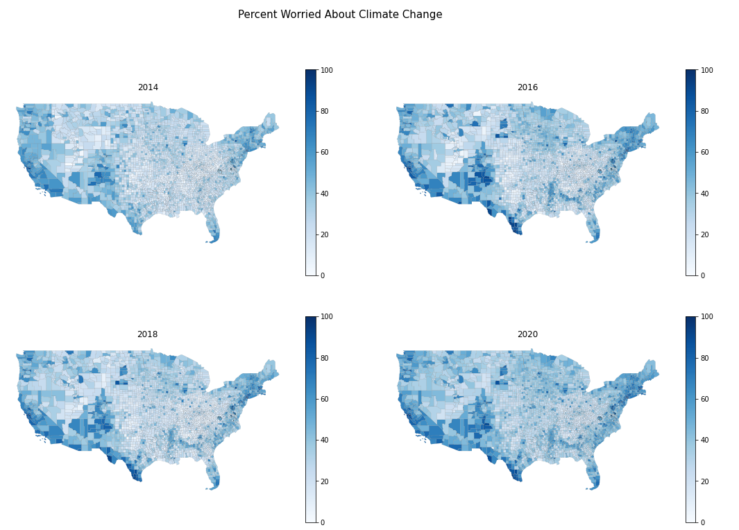
EDA: Data Visualization and Trends
Percent Support for CO₂ Limits on Power Plants
Percent Worried About Climate Change

Slide 8
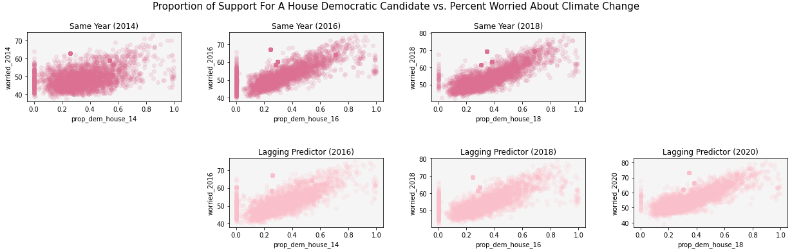
EDA: Data Visualization and Trends
Percent Support for A House Democratic Candidate vs. Percent Worried About Climate Change

Slide 9
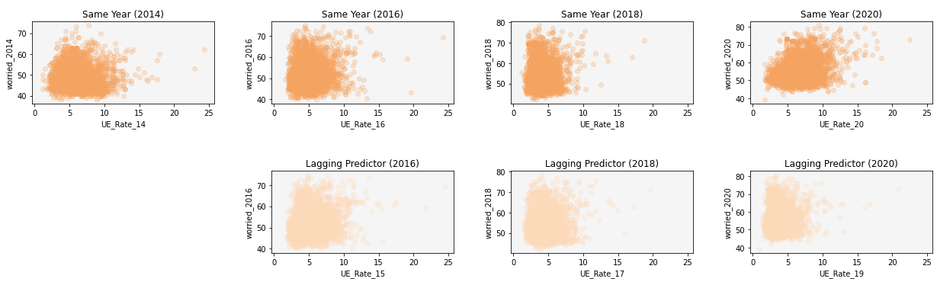
EDA: Data Visualization and Trends
Unemployment Rate vs. Percent Worried About Climate Change

Slide 10
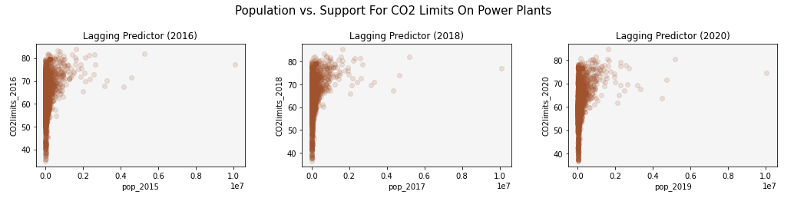
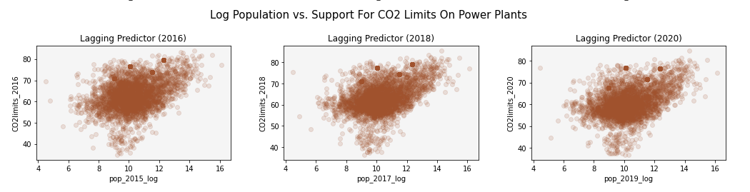
EDA: Data Visualization and Trends
County Population vs. Support For CO₂ Limits on Power Plants
Log of County Population vs. Support For CO₂ Limits on Power Plants

Slide 11
Modeling: Rationale
Method | Reasoning & Details
Decision Trees | Optimized max_leaf_nodes, max_features, & max_depth Avoids overfitting Easy to follow, tangible results
KNN | Better captures non-linearity Performed the worst
Gradient Boosting | Chosen because of decision tree performance Ensemble Method has better results
Ridge & Lasso | Parametric methods that prevent overfit Ability to do feature selection or handle correlated features was desirable

Slide 12
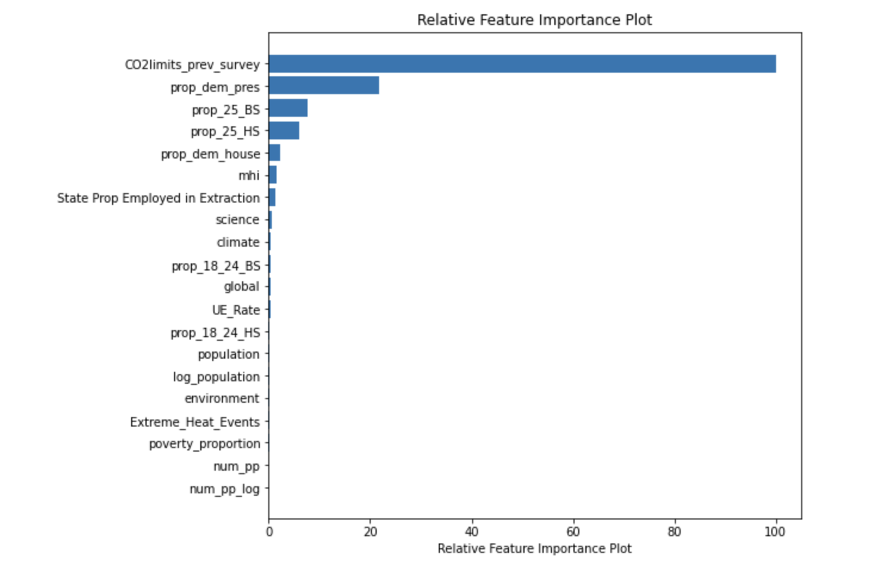
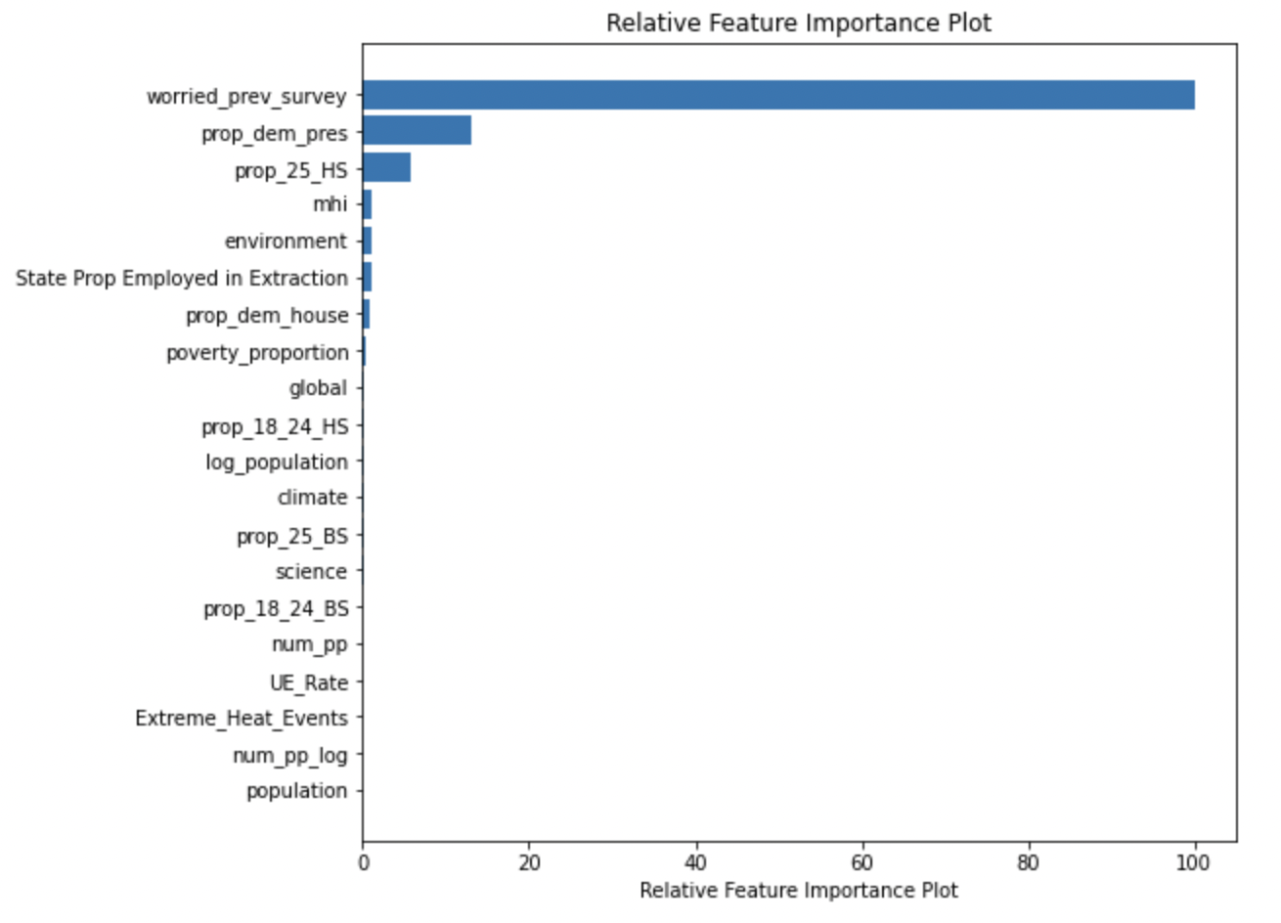
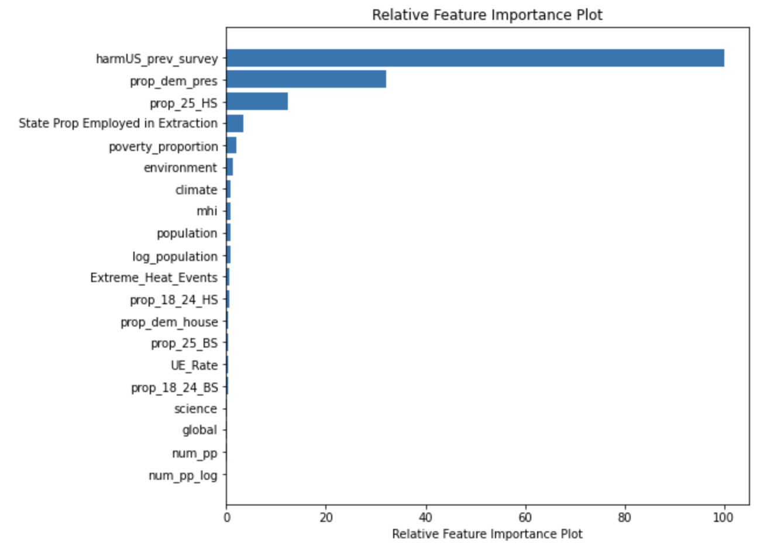
Modeling: Results
Feature Importance: Support For CO₂ Limits
Feature Importance: Percent Worried
Feature Importance: Percent US Harmed
Decision Trees
Lasso & Ridge Regression
Gradient Boosting
KNN
Notes:
Most important features in decision tree: previous survey results, prop+dem_pres, educational attainment for 25 year olds (BS and HS)

Slide 13
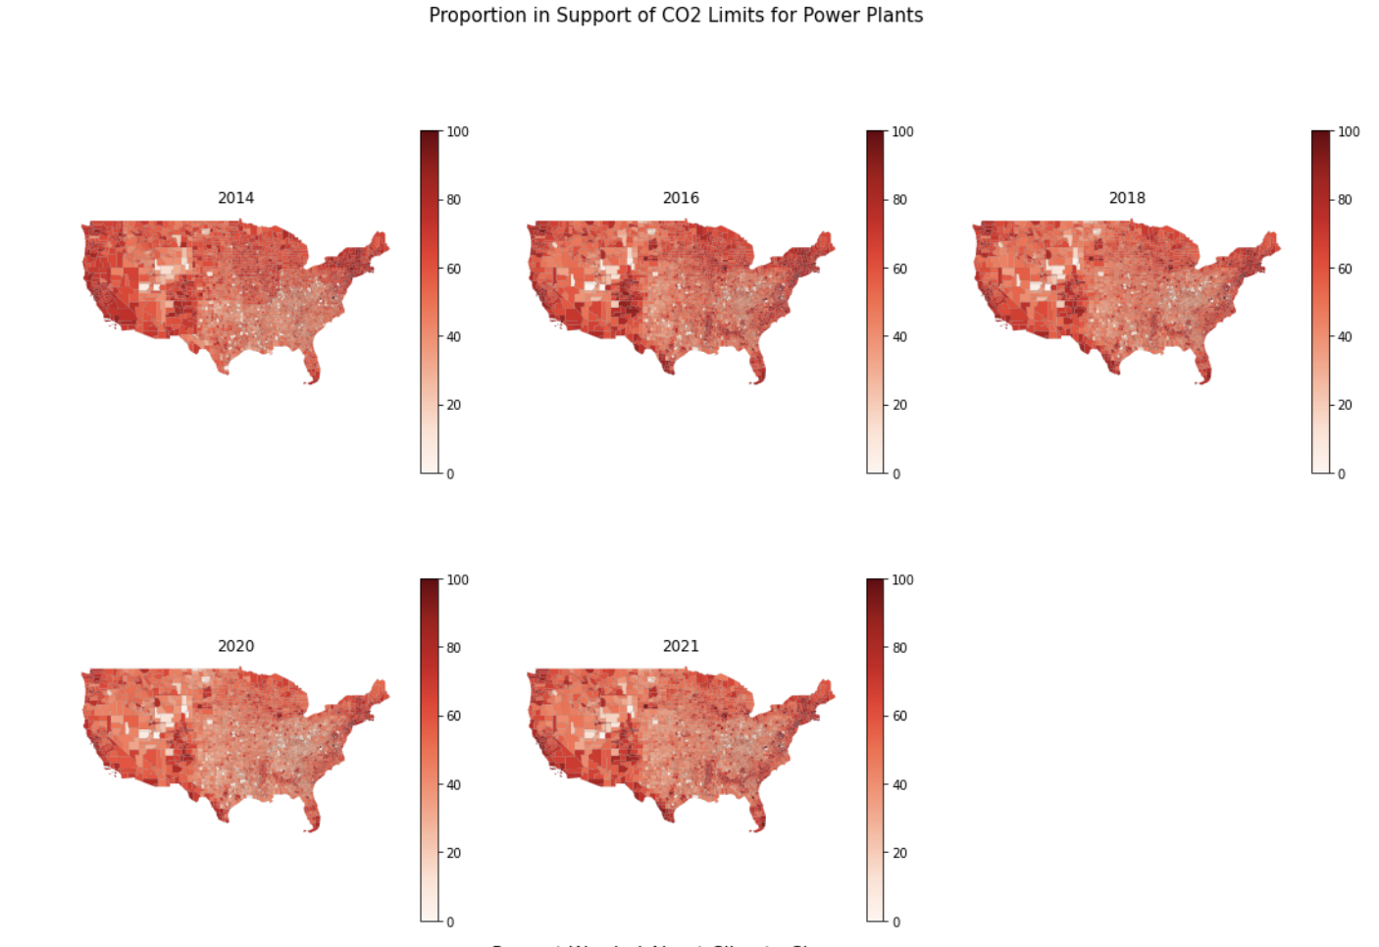
Key Takeaways: Resource Allocation for 2021
Recommendation
Percent Support for CO₂ Limits on Power Plants
Spend more money on advertising in Midwest
The Midwest continues to have low belief in climate issues even as support nationwide rises.
Focus advertising away from coasts
Coastal regions projected to have strong support (across all three questions). Divert money away from those areas.
Lean into climate issues
In Florida and Texas, Democratic campaigns should take advantage of climate-minded voters going unheard.

Slide 14



Limitations of Model, Overall Reflections
Data: It is hard to find data that is nationwide at a county-level from 2014-2020. This need created a reliance on demographic data, which might not be the absolute best predictors.
Lack of variation: For some questions (e.g. CO2 limits), there was not a ton of variation (e.g. support is generally above 50-60%). While there was still variation across counties, if the data varied more (e.g. if we had target data from 2008), the model might better be able to fit data to predict changes in support.
Potential for Change: Unlike natural processes (e.g. rate of gravity), things that influence human opinion, especially on political issues, can change quickly. If that happens, the model might not perform as well—it would need to be retrained.

